Slide 1
Solar Charger For Mobile Phones
DONE BY
GUIDED BY
S.Naveen Kumar(I.T-A)
L.Gourav Kumar(I.T-A)
Dr.Chithra Selvaraj
Associate Professor
Department of Information Technology
SSN College of Engineering

Slide 2
MOTIVATION
Problems Faced By The Current Smartphones :
Increased battery consumption by high end apllications.
Faster draining rate ( Reduced Battrey Life).
Consumption of electricirty while chariging (i.e, to reduce the dependencies on the electric board panel)

Slide 3



PROBLEM STATEMENT
Nowadays the usage of smartphones
had increased to an immense level, and the important problem faced the smartphones is the battrey consumption. What if this problem could be solved by nature? .
Our project focuses on charging these mobile phones using the solar
energy.
OR

Slide 4
Technical Perspective
This project uses the technical concepts as:
Solar-Cell Technology.
Electrochemisrty.
Concept of Photo-Voltaic Cell.

Slide 5
Solar Cell Technology : Phenomena that converts the energy of light directly into electricity by the photovoltaic effect, which is a physical and chemical phenomenon
Electrochemistry : This concept is used in oder to explain about the internal process which take place inside the cell to convert the available chemical energy to form of electrical energy.

Slide 6
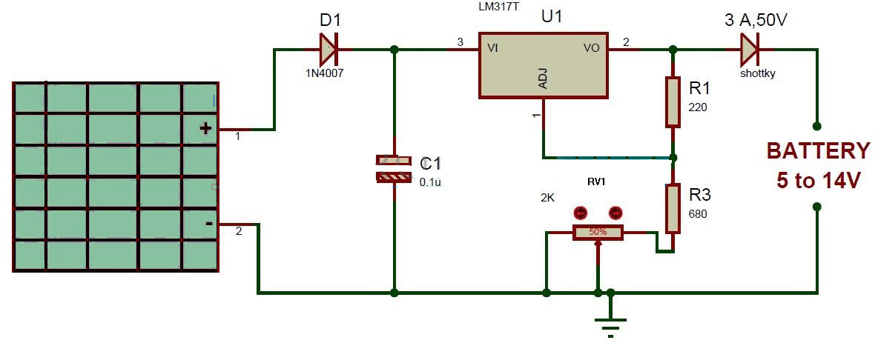
MECHANISM

Slide 7
MECHANISM
Solar battery charger works on the principle that the charge control circuit will generate the constant voltage.
Along with the solar panel adaptor kit is also required to make an intermidiate connection between the panel and the mobile battery.
A charge controller or charge regulator is basically a voltage and/or current regulator to keep batteries from overcharging. It regulates the voltage and current coming from the solar panels going to the battery.
Most "12 volt" panels put out about 16 to 20 volts, so if there is no regulation the batteries will be damaged from overcharging. Most batteries need around 14 to 14.5 volts to get fully charged.

Slide 8
The electricity collected using solar panel is regulated to the required voltage using the solar charge controller which is then passed through the cable connectors to the battery.
The adaptor kit which is associated with the solar panel act a intermediate device.
The electricity which is collected is used to carry out the chemical process inside the battery so that reverse process takes place and the battery gets charged.

Slide 9
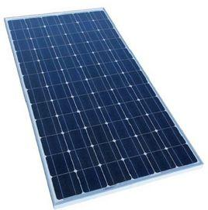
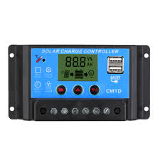
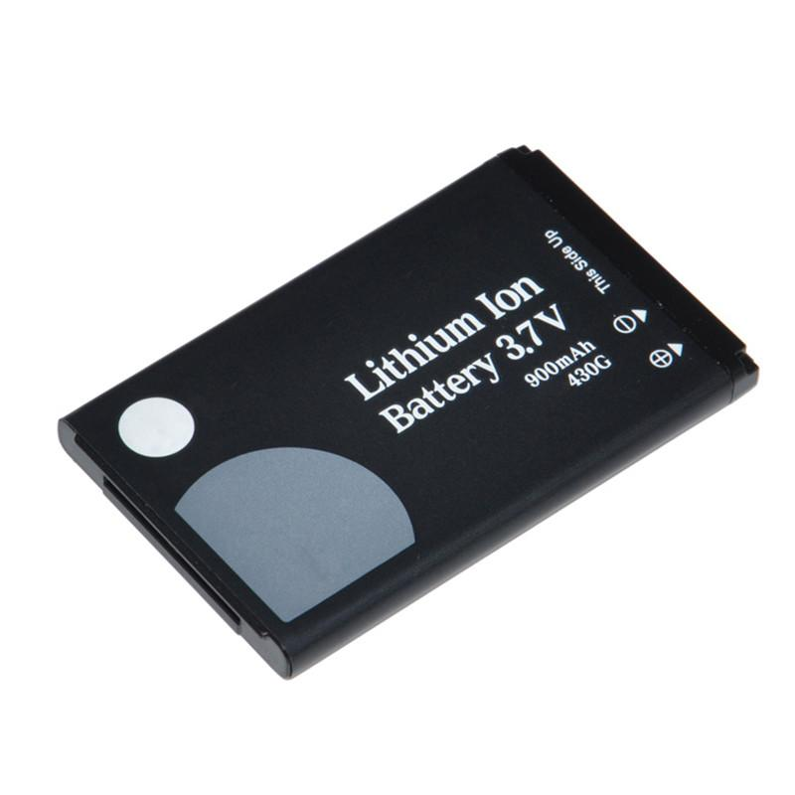
HARDWARE COMPONENTS
Solar Panel (5 inch) and adapter kit.
Cable Connectors (3.5 mm jack).
Rechargable Battery (2500mah).
Solar charge controller.

Slide 10
BUDGET
S.No | Item Description | Cost(Rs)
1 | Solar Panel (5 inch) and adapter kit. | 3000
2 | Cable Connectors (3.5 mm jack) | 1000
3 | Rechargable Battery (2500mah) | 1000
4 | Solar charge controller. | 1000
5 | miscellaneous | 1000
 | Total | 7000

Slide 11
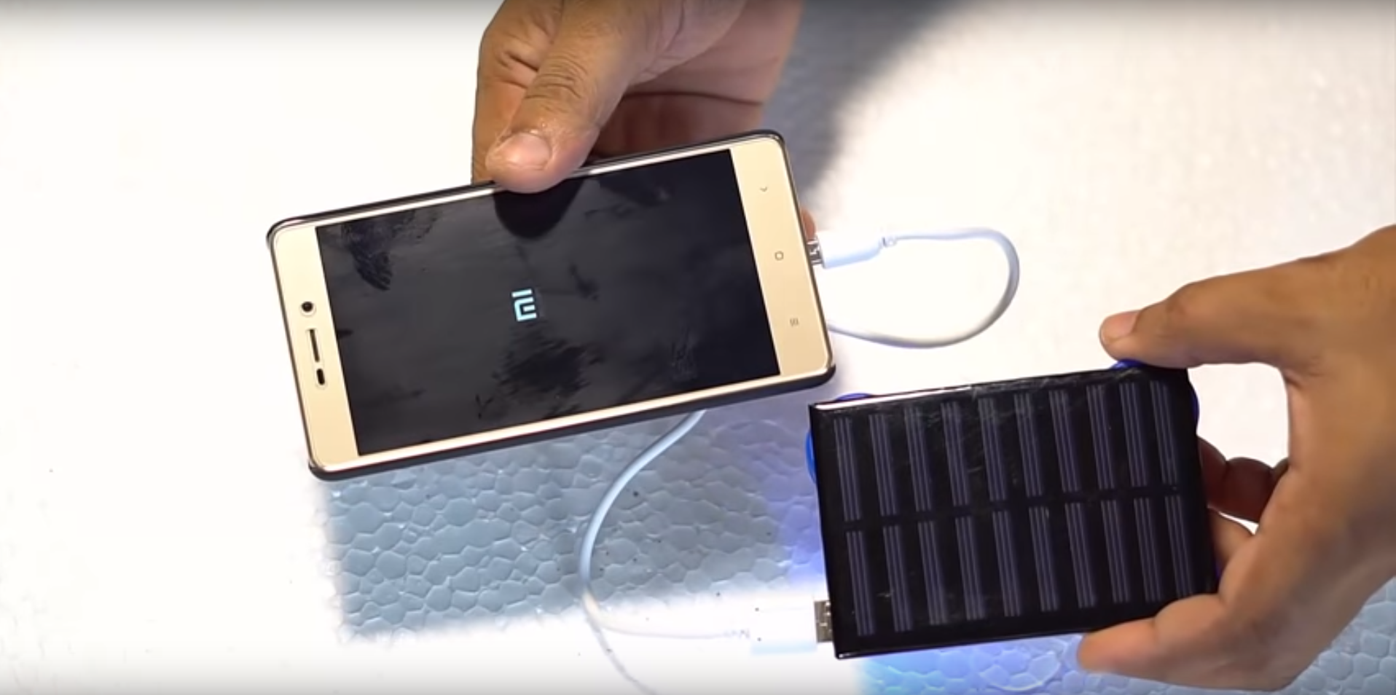
RELATED WORKS

Slide 12
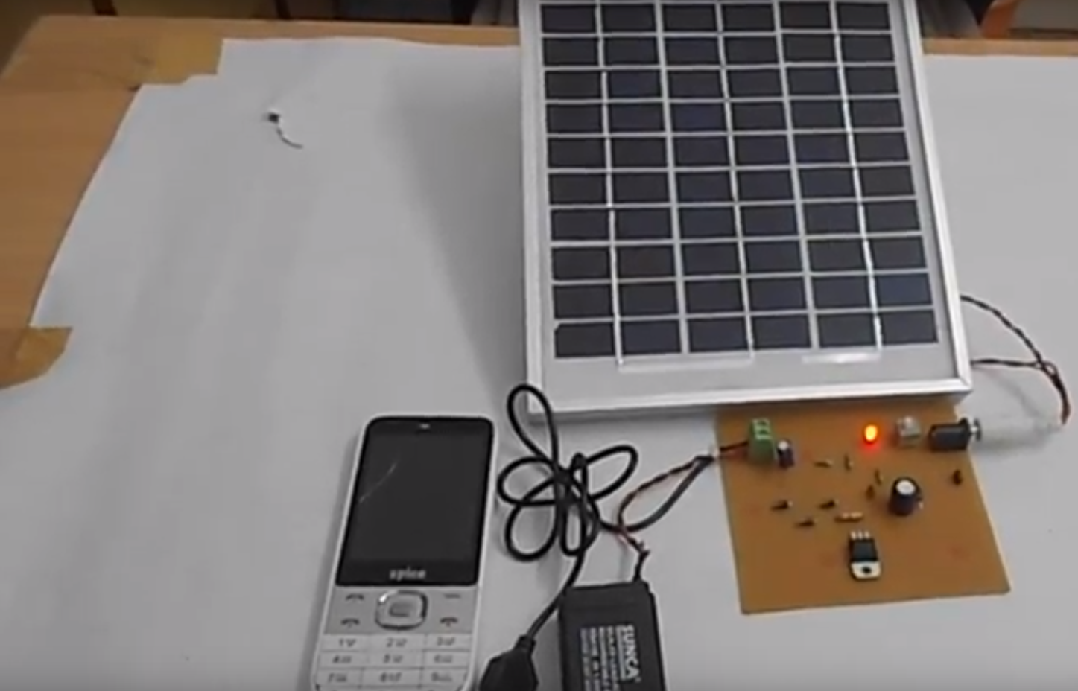
RELATED WORKS

Slide 13
REFERENCES
http://www.12voltsolarpanels.net/charge-your-cell-phone.
"Samsung launches E1107 Crest Solar cell phone". mobileburn.com. Retrieved 2011-06-29.
https://m.youtube.com/watch?v=xKxrkht7CpY
Lacap, A.M., et al. (2004) Solar Power Harvester. Undergraduate Thesis, Lyceum of the Philippines.
Nolasco Jr., E.L. (2008) Enhance Solar Powered Wireless Weather Station Multi Source Cellular Phone Charger. Master’s Thesis, Bulacan State University, Bulacan.

Slide 14
THANK YOU :)

